Slide 1
RESEARCH AUDIT · DDOS BENCHMARKING
Near-100% accuracy claims often fail in the real world
An independent empirical reproduction of streaming intrusion detection on real network Big Data.
Reproducibility Crisis
Pervasive Leakage
Unverified Claims
Models report near-100% accuracy in lab trials, then collapse under real traffic.
Random packet splits leak identical connection bursts directly into test sets.
Kafka and Spark Streaming were claimed to boost accuracy by 3% to 7%.
Notes:
Open by framing the reproducibility crisis in ML-based intrusion detection: paper claims of 99.9% accuracy collapse when tested against temporal shifts, leakage, and uncurated traffic.

Slide 2
Methodology
Audit Scope
Five objectives drove the audit
A rigorous empirical verification protocol designed to evaluate mathematical rigor, streaming infrastructure, and cross-day generalization.
01
02
03
04
05
Audit Paper Math
Test "Kafka Boost"
Cross-Day Split
Zero-Day & Ports
Scale to 70M Rows
Establish authentic Day 1 train / Day 2 test benchmarks, eliminating temporal overlap.
Measure robustness against unseen attack vectors without shortcut port features.
Scrutinize published confusion matrices, sample sizes, and arithmetic consistency.
Compare streaming pipelines against identical offline batch inference runs.
Process the full 30 GB dataset out-of-core on commodity Colab GPU infrastructure.
2
Notes:
Walk through the five core audit pillars: verifying arithmetic integrity, isolating streaming effects, enforcing clean temporal separation, testing generalization without shortcut ports, and scaling to full dataset volume.

Slide 3

FLAW IDENTIFICATION
The paper's confusion matrices cover only 270 flows
While claiming an evaluation over 2 million unmodified flows, published matrices sum to an evaluation sample of mere hundreds.
99.9996%
Demo Sample, Not Big Data
Total data discarded. Figure 4 totals exactly TP + TN + FP + FN = 270 per model across the evaluation.
A 270-flow test set cannot establish statistical significance or prove enterprise streaming reliability.
3
Notes:
Point out the arithmetic discrepancy: despite claims of testing millions of flows, Figure 4's matrix cells sum to exactly 270. Over 99.999% of data was omitted from final validation tables.

Slide 4
Experimental Design
Data Partitioning
Three setups, one honest benchmark
Demonstrating how evaluation topology dictates reported accuracy through packet correlation and temporal memorization.
SETUP A
SETUP B
SETUP C · AUDIT STANDARD
99.97%
100.00%
98.4–98.98%
Random 80/20 Split (Day 1)
Time Split (Within Day 1)
Severe packet leakage. Packets from identical connection bursts are distributed across train and test sets, artificially inflating metrics.
Memorization artifact. The model overfits to the active tool signatures and packet structures of that specific day's attack generation toolset.
Cross-Day Benchmark
Train Day 1, test Day 2. All 11,357 cross-day duplicate flows eliminated via cryptographic hash, establishing an authentic evaluation ceiling.
4
Notes:
Explain how setup choice completely alters findings. Random split leaks packets (99.97%), chronological split within a day memorizes tools (100%), but rigorous cross-day separation proves the real benchmark sits around 98.4% to 99.0%.

Slide 5
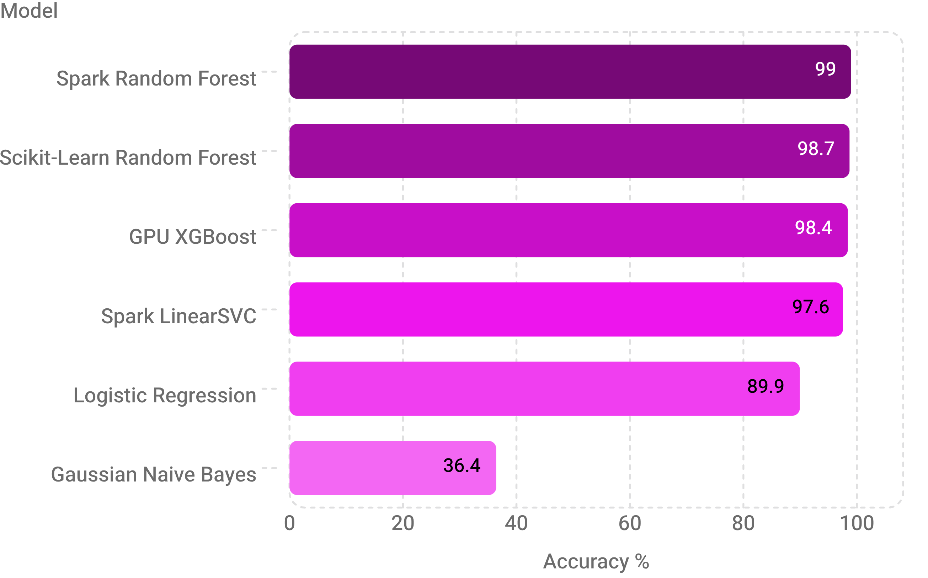
Model Comparison
Cross-Day Generalization
Tree ensembles hold up across days
SETUP C EVALUATION · 5 FIXED SEEDS (42, 123, 456, 789, 1024)
Tree architectures capture non-linear packet dynamics that survive time shifts. Linear and probabilistic classifiers collapse when independence assumptions fail.
GPU XGBoost Performance
99.82% Recall · 99.01% F1 Score across all temporal splits.
5
Notes:
Present the model comparison under Setup C across 5 random seeds. Tree models (Random Forest, XGBoost) maintain ~98.4–99.0% accuracy, while Naive Bayes completely degrades to 36.4% due to feature correlation violations.

Slide 6
Detection Efficacy
Confusion Breakdown
Only 76 attacks missed out of 128,391
Evaluating Random Forest on Setup C with 173,454 unique flows (642× larger than the original paper's sample size).
TRUE POSITIVES
TRUE NEGATIVES
FALSE POSITIVES
FALSE NEGATIVES
128,315
42,868
2,195
76
99.94% Recall
95.13% Specificity
4.87% False Alarms
0.06% Miss Rate
Attacking flows accurately identified and mitigated.
Benign connections permitted without disruption.
Innocent connections flagged as malicious.
Only 76 attack flows evaded classification.
Crucially, the evaluation preserves 100% of unique Day 2 benign user flows, verifying that genuine traffic integrity is safeguarded.
6
Notes:
Emphasize the scale and fidelity: testing 173,454 flows rather than 270 yields 99.94% recall with only 76 misses out of over 128,000 attacks, preserving legitimate users.

Slide 7
Streaming Evaluation
Architectural Impact
Kafka adds speed, not accuracy
Auditing the purported 3% to 7% accuracy increase attributed to streaming pipelines over batch inference.
THE ORIGINAL CLAIM
EMPIRICAL AUDIT RESULT
Claimed +3% to +7% Gain
100.00%
The paper asserted that streaming through Kafka and Spark Structured Streaming micro-batches lifted XGBoost accuracy from 92% to 95%.
Identical Predictions · Zero Variance
Running identical data through offline batch and Spark micro-batches produced an exact 1:1 prediction match. Kafka confers zero predictive advantage.
Hypothesis: transport infrastructure somehow alters mathematical inference.
Production throughput: 14,125 flows/second at a median latency of 33.82 ms.
7
Notes:
Directly debunk the claim that streaming infrastructure boosts model accuracy. Streaming identical inputs yields 100.00% identical outputs compared to batch inference; its true value is low latency and high throughput.

Slide 8
Robustness
Feature Dependency Audit
Zero-day attacks are caught; linear models lean on port shortcuts
Ablation experiments reveal which models learn genuine traffic dynamics versus static metadata memorization.
ZERO-DAY GENERALIZATION
DESTINATION PORT STRIPPED
FULL METADATA ABLATION
99.5–99.9%
89.26%
25.90%
Random Forest Resilient
Linear Models Collapse
Remove destination port: Random Forest still 89.26%.
Remove port, duration, and ACK flags: linear models fall to 25.90% specificity, blocking 3 of 4 innocent users.
Unseen Portmap Attack
Unseen Portmap attack: recall 99.52% to 99.95%.
Trees learn packet variance (Packet Length Std importance ≈ 0.20).
8
Notes:
Review the ablation study: tree models maintain high recall on completely unseen Portmap attacks, whereas linear models rely almost entirely on port and flag shortcuts, collapsing to 25.9% specificity when stripped.

Slide 9
Limitations and real-world nuances
Extreme imbalance
Single-attack port shortcuts
Closed-source paper
0.16% benign, so raw accuracy can hide false alarms; watch specificity
TFTP port 69 vs SYN port 80 scores 99.58%; mixing attacks is necessary
No seeds or partition indices, so we reconstructed with Wilson intervals
9
Notes:
Extreme imbalance: 0.16% benign, so raw accuracy can hide false alarms; watch specificity. Single-attack port shortcuts: TFTP port 69 vs SYN port 80 scores 99.58%; mixing attacks is necessary. Closed-source paper: no seeds or partition indices, so we reconstructed with Wilson intervals.

Slide 10
Audit Summary
Conclusion
Four contributions
Correcting the record on big data intrusion detection benchmarks and production streaming efficacy.
01
02
03
04
Honest ~98% Benchmark
Kafka Boost Disproven
Flaws Documented
Production Feasibility
Paper inconsistencies documented: N=270, Table 4 errors up to 9.1%, overlapping error bars.
Production is feasible: under 35 ms latency and over 9M flows/s on commodity hardware.
The honest benchmark is about 98%: 98.40% to 98.98% cross-day, versus 100% from leakage and the paper's 74% to 93%.
The Kafka accuracy boost is disproven: 100.00% match with offline inference.
Notes:
Conclude with the four primary takeaways: the realistic ~98% benchmark, debunking the streaming accuracy boost, documenting mathematical flaws in the literature, and proving real-time feasibility on commodity hardware.

